Slide 1

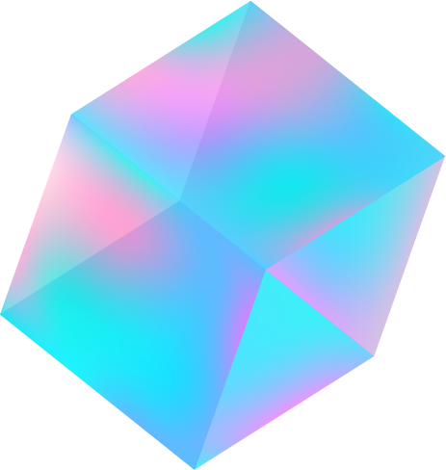
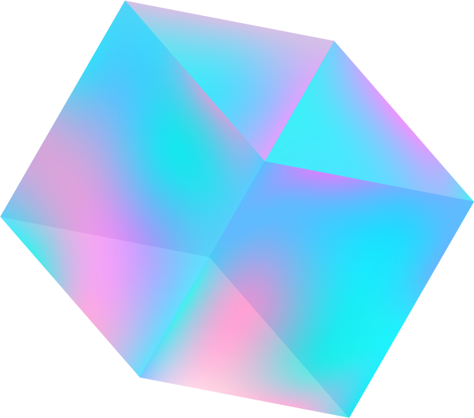

Social Network Analysis
3501- Dhruvi Swadia
3506- Aishani Anavkar
3509- Sandesh Kotwal

Slide 2
Introduction to SNA
Social Network Analysis (SNA) is the process of exploring or examining the social structure by using graph theory.
SNA is It is used for measuring and analyzing the structural properties of the network
It helps to measure relationships and flows between groups, organizations, and other connected entities.
It characterizes networked structures in terms of nodes (individual actors, people, or things within the network) and the ties, edges, or links (relationships or interactions) that connect them.

Slide 3
Network Analysis Terminology
Edge
Path
Component
Node Degree
A line indicating a link between vertices is called an edge.
The edges followed from one vertex to another are called a path.
A group of vertices that are mutually reachable by following edges on the graph is called a component.
The degree of a node in a network is the number of connections it has to other nodes

Slide 4
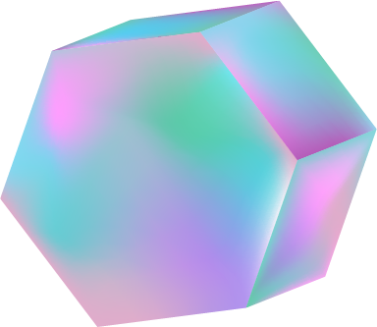

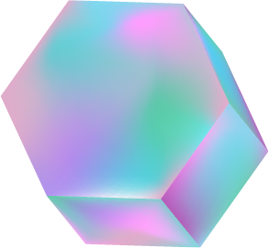
Steps followed for SNA
01
02
03
04
Data Collection
Coding
Data Visualization
Conclusion

Slide 5
01
Data Collection

Slide 6
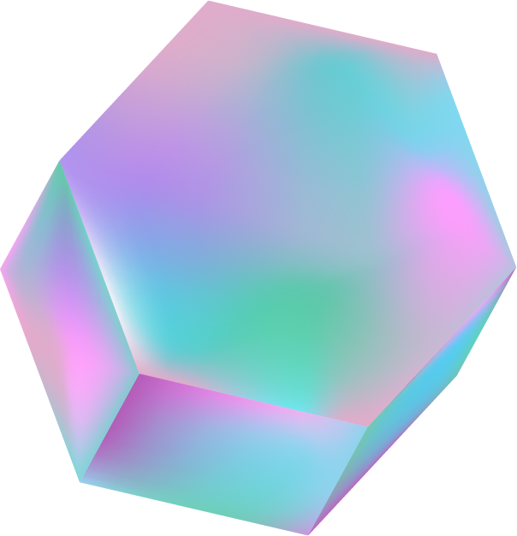
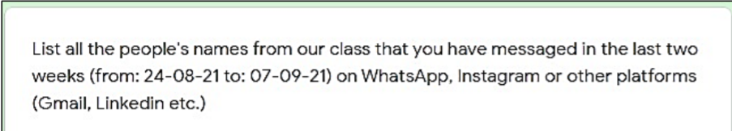
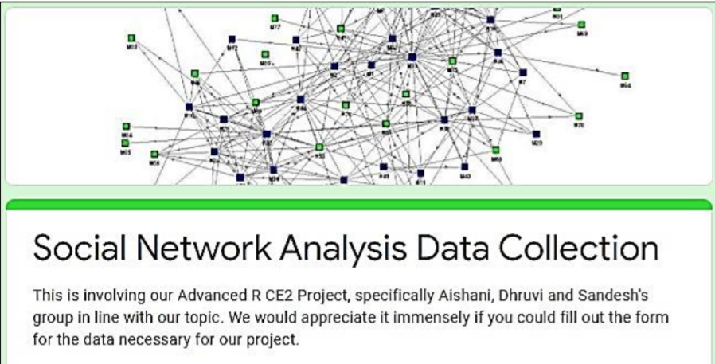
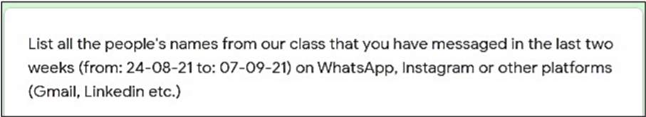
Data Collection
We performed a survey within our class in order to analyze the social interactions among our classmates primarily through means of WhatsApp and Instagram.
Input 1
Input 2
Input 3

Slide 7
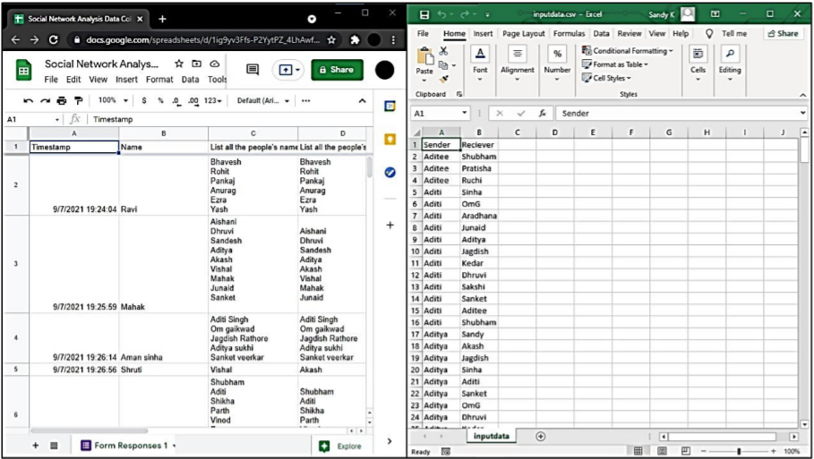
Image shows raw Data from all the 40 responses.
Responders were asked to filled out both received and sent messages (interactions) in order to minimize human error and/or bias in case of e.g., a responder forgetting about a message they received (would otherwise make a "hole" in the datapoints) would be compensated by the opposite node since they likely report on the same interaction that the first responder forgot.

Slide 8
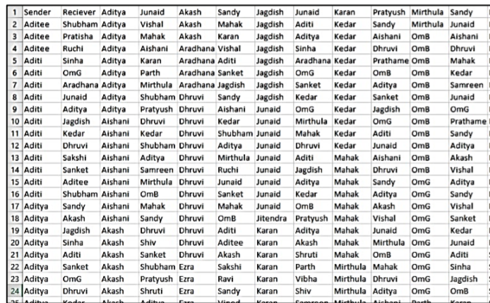
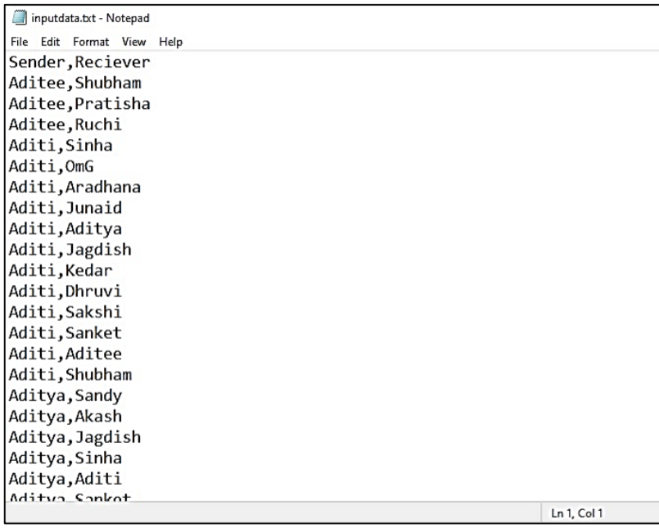
All spam/troll responses were removed manually alongside removing "invalid" response (people that failed to submit a response but were part of the response pool received) followed by transposing data into a usable .csv file. After filtering everything out a .csv is created that roughly distinguishes the collected data.

Slide 9
02
Coding

Slide 10
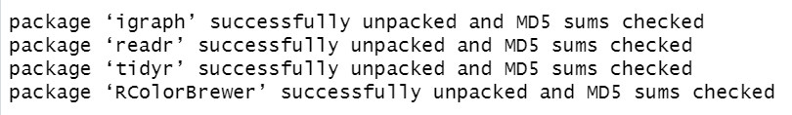
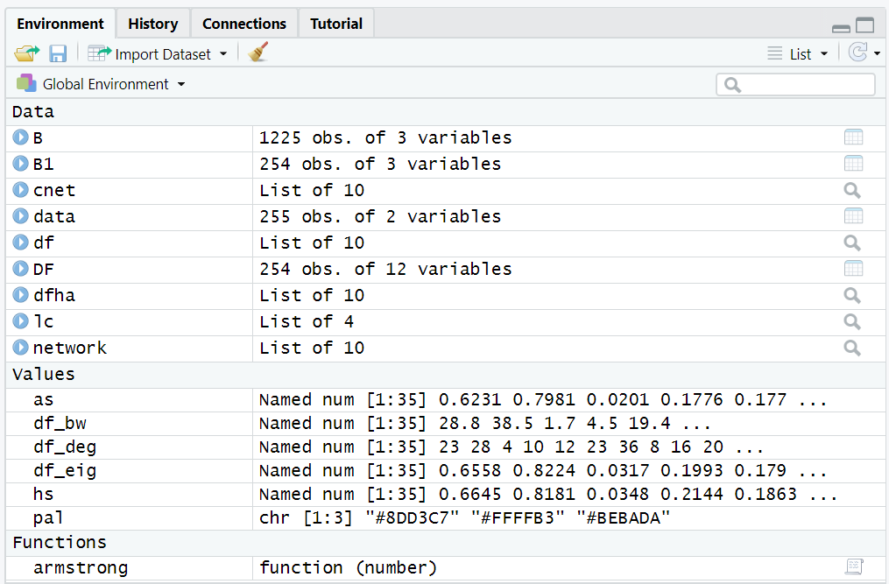
Code
Required packages are installed
Data is stored in the variables of the R global environment

Slide 11
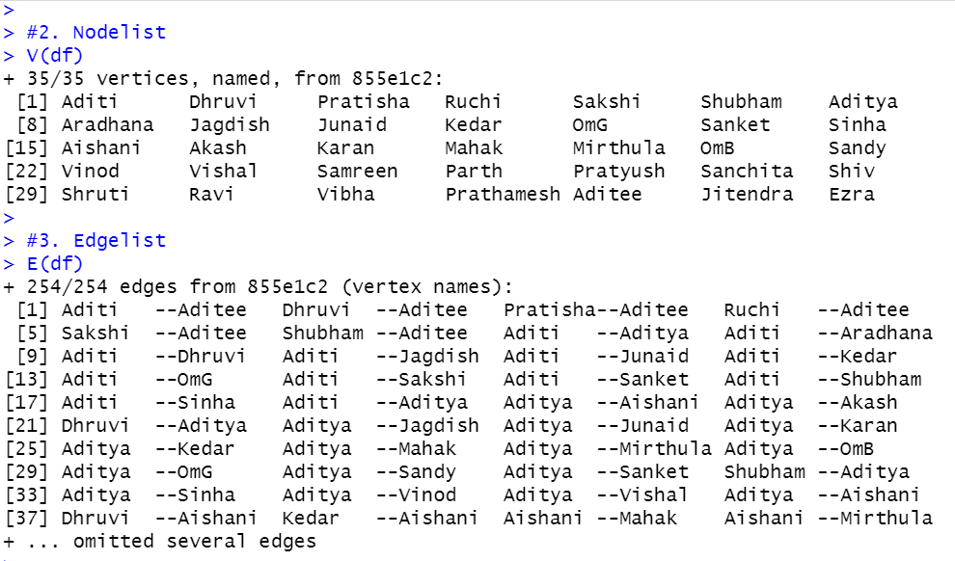
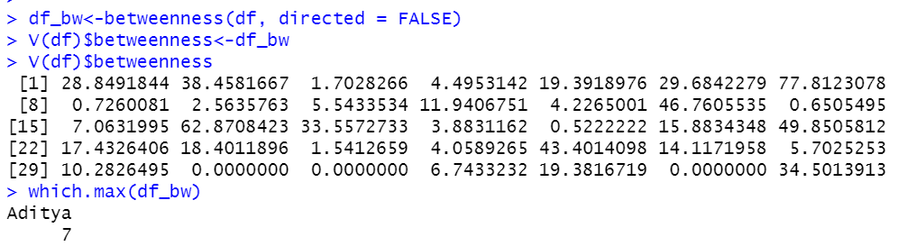
A nodelist and edgelist is created using the igraph library
Betweenness of the raw values is shown

Slide 12
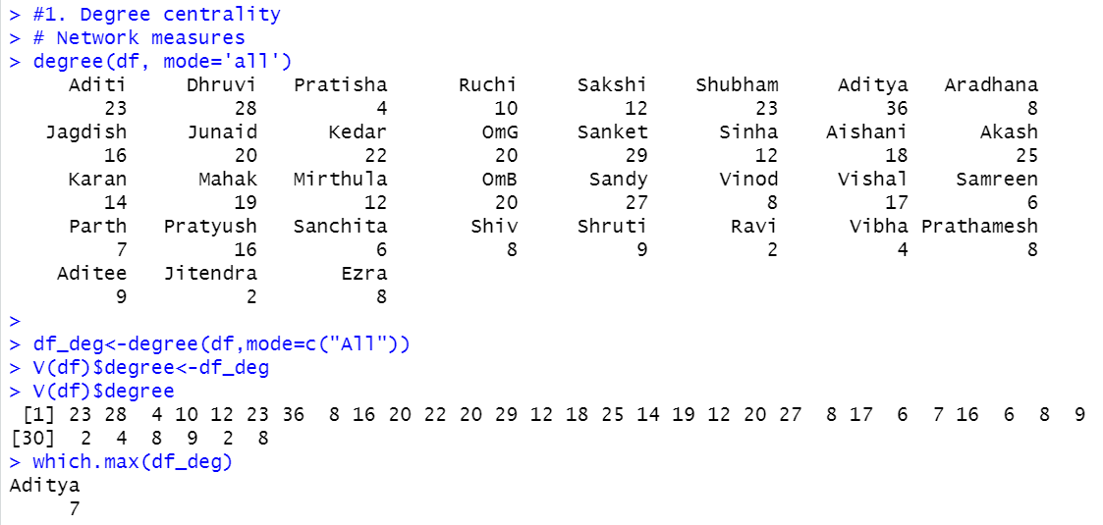
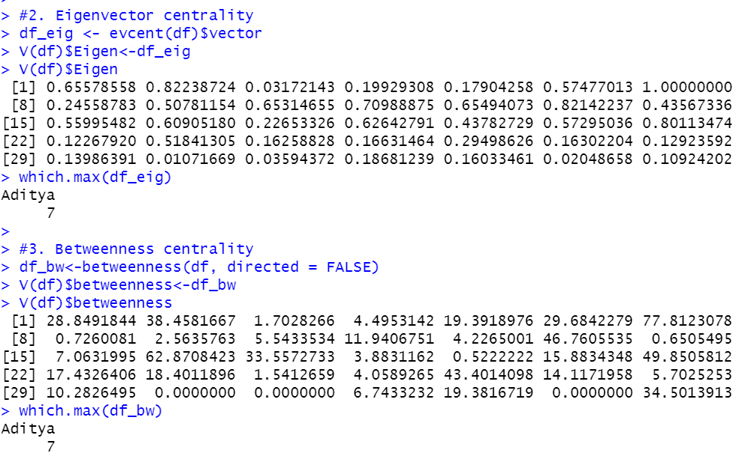
Degree data is found
Eigenvector centrality and the betweenness centrality the same maximum

Slide 13
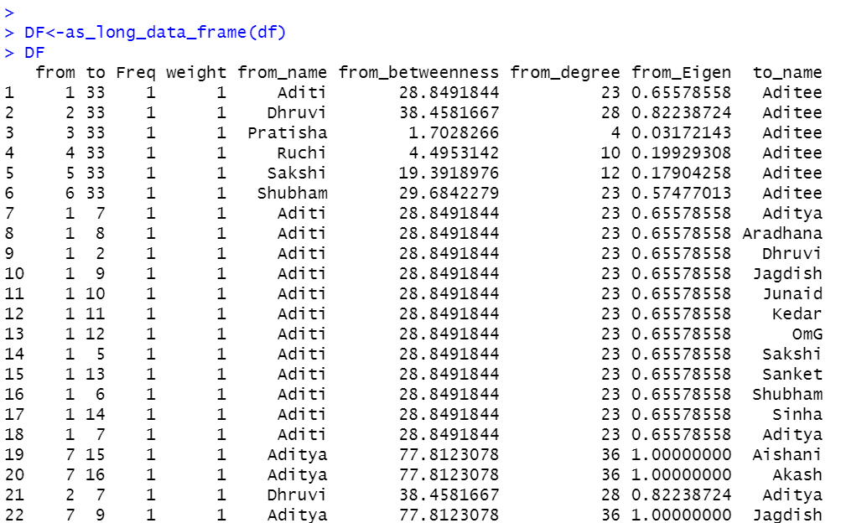
Summary of data

Slide 14
03
Data Visualization

Slide 15

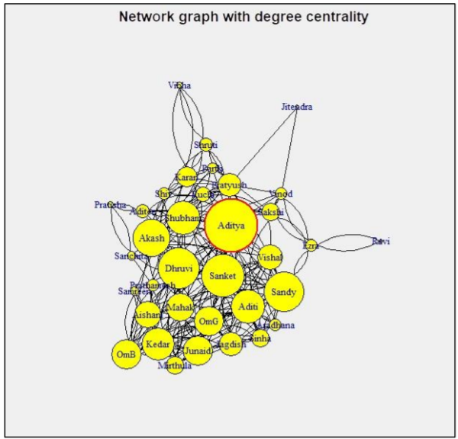
Network graph with degree centrality:
This is a graph which shows the network on the basis of degree centrality. Its vertices depict the betweenness. I.e.: Bigger the vertex, higher the betweenness.
The layout used here is the Fruchterman Reingold layout.

Slide 16
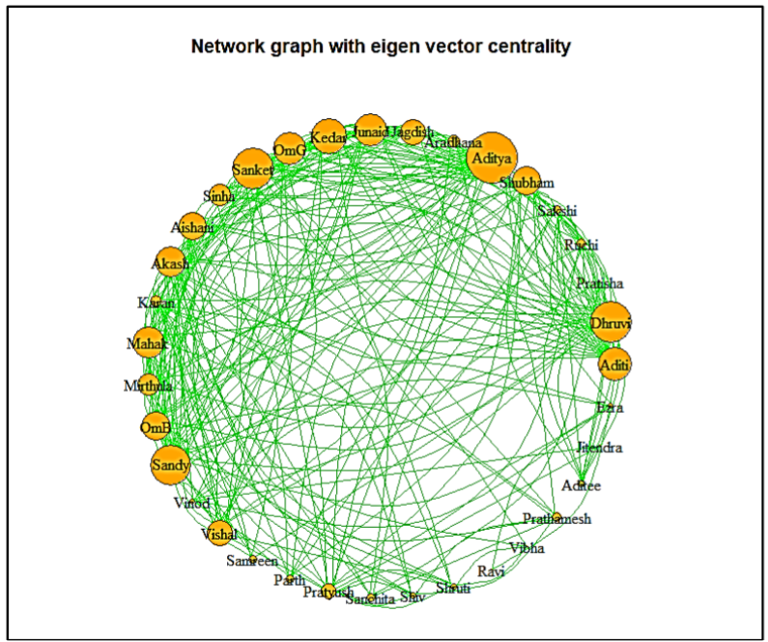
Network graph with eigen vector centrality:
Eigenvector centrality is a measure of the influence a node has on a network.
If a node is pointed to by many nodes (which also have high eigenvector centrality) then that node will have high eigenvector centrality.

Slide 17
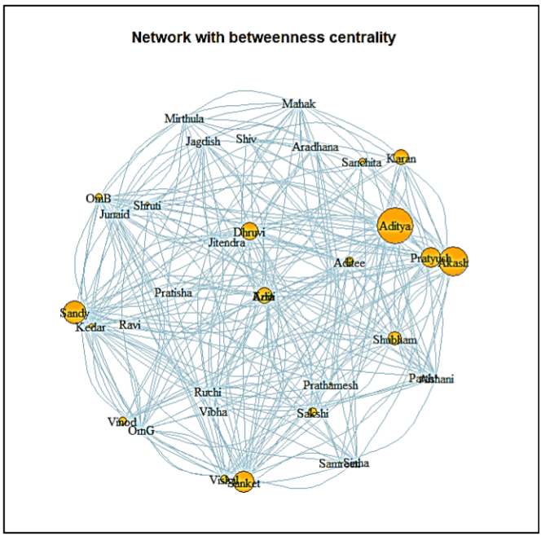
A network with betweenness centrality:
Betweenness centrality finds wide application in network theory; it represents the degree to which nodes stand between each other.
A node with higher betweenness centrality would have more control over the network, because more information will pass through that node.

Slide 18
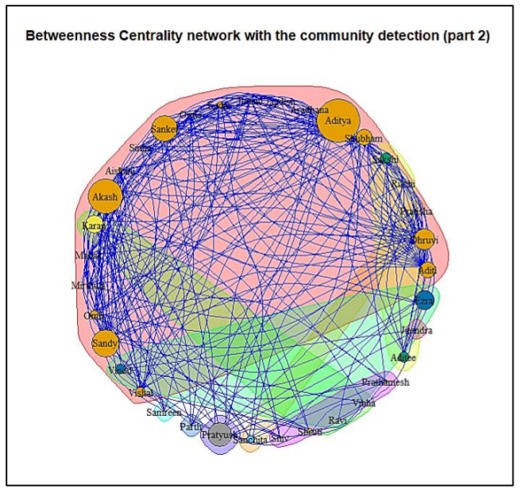
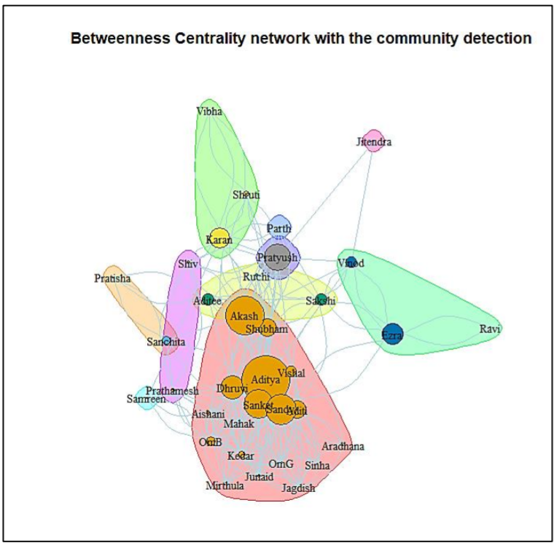
Betweenness clarity network with community detection:
Detecting communities in a network is one of the most important tasks in network analysis.
In a large-scale network, such as an online social network, we could have millions of nodes and edges.
Detecting communities in such networks becomes a herculean task.

Slide 19
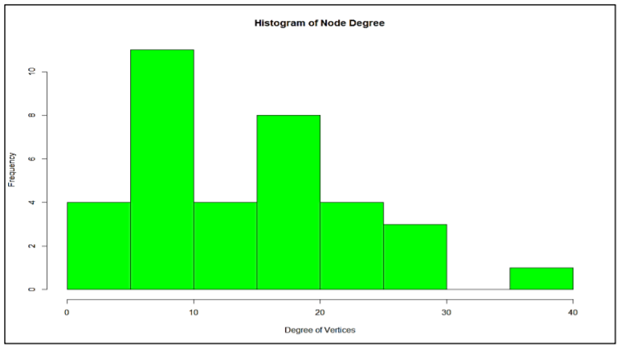
Histogram:
A Histogram is a chart plotting a variable, against the number of occurrences in the variable category.
It is a quick way to get information about a sample distribution without detailed statistical graphing or analysis.
This plot will show you if your data values are centered (normally distributed), skewed to one side or the other, or have more than one 'mode' - localized distribution concentrations.

Slide 20
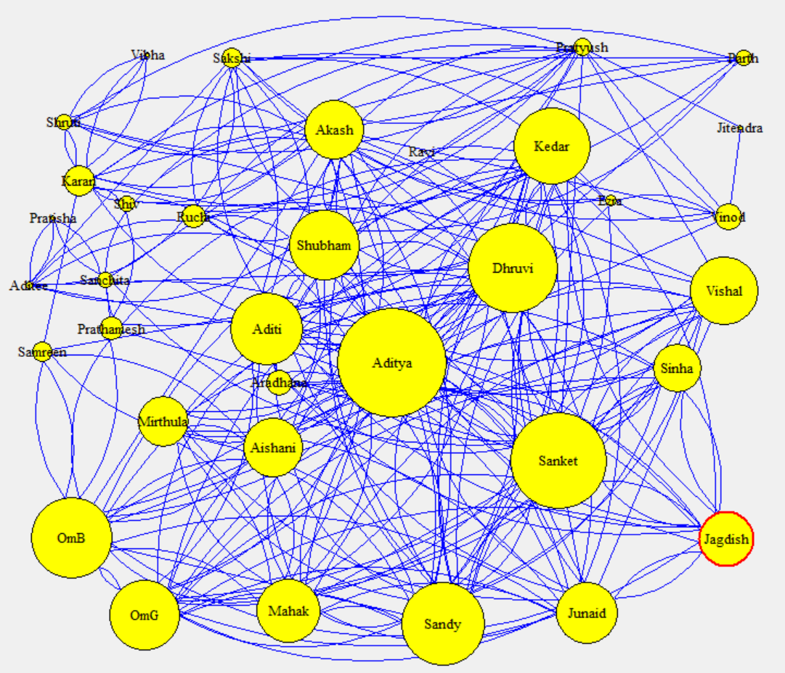
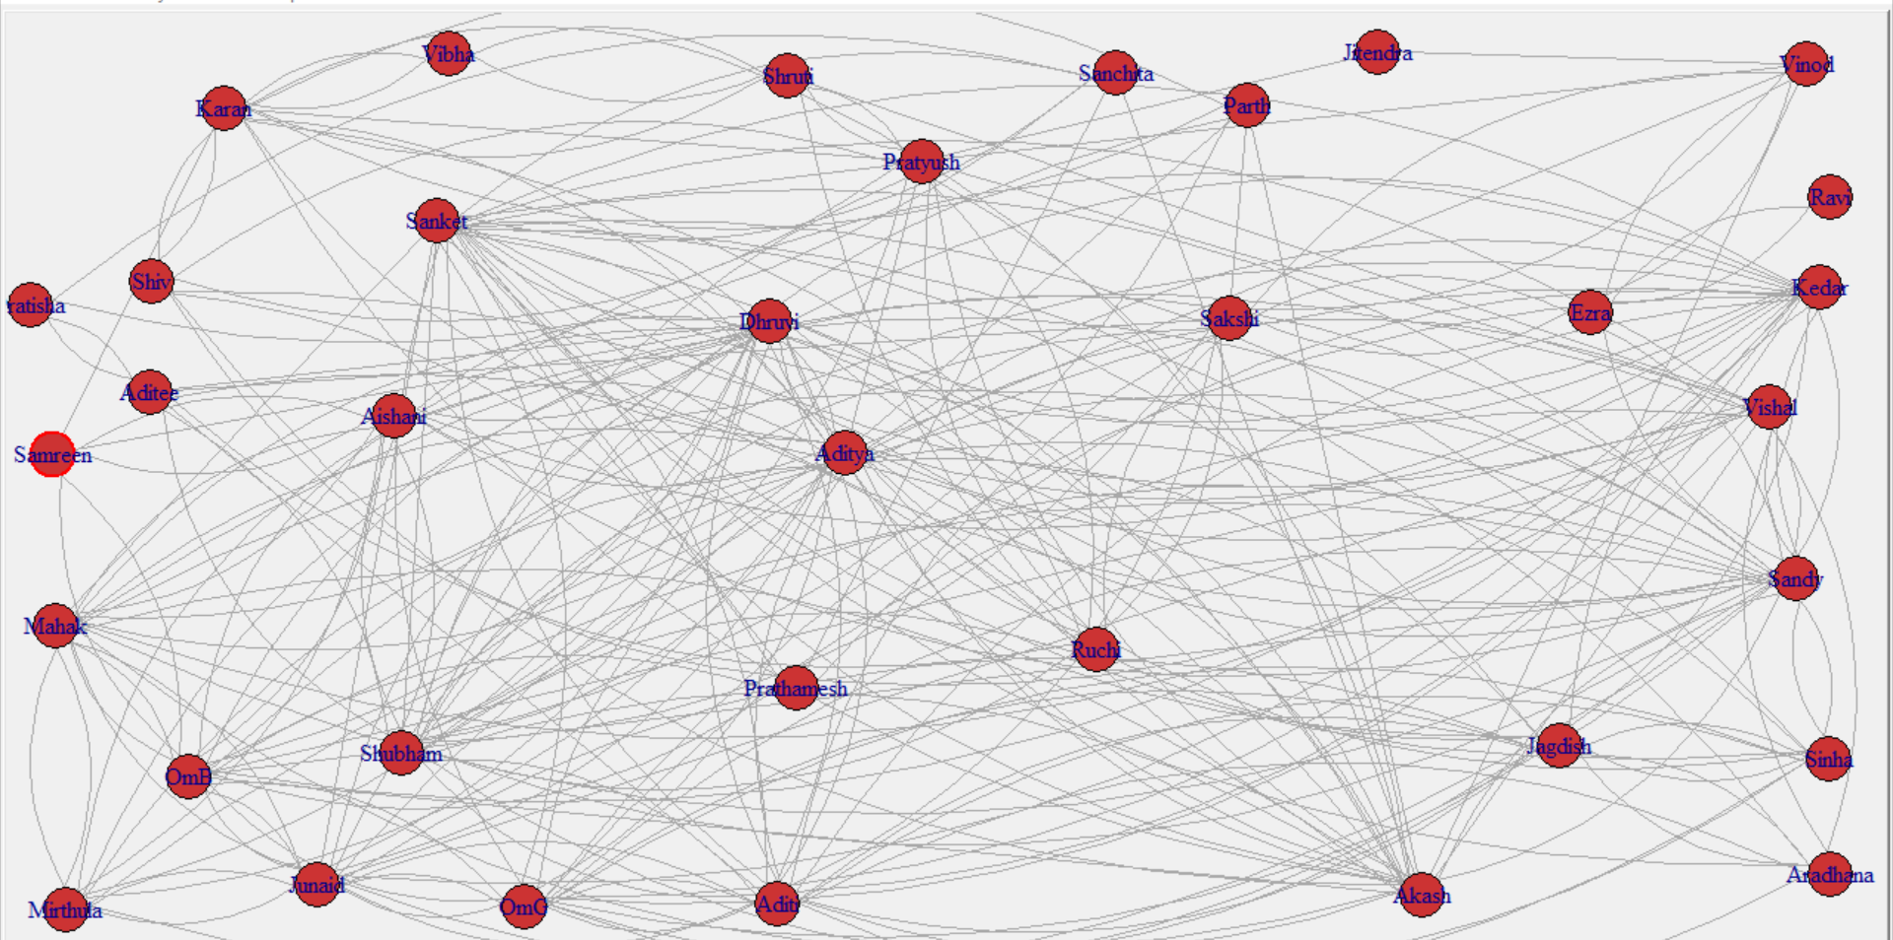
INTERACTIVE PLOTTING:
TkPlot: The tkplot command creates a new Tk window with the graphical representation of graph. Ttkplot and its companion functions serve as an interactive graph drawing facility. Not all parameters of the plot can be changed interactively right now though, eg. the colours of vertices, edges, and also others have to be pre-defined. tkplot is an interactive graph drawing facility. It is not very well developed at this stage, but it should be still useful

Slide 21
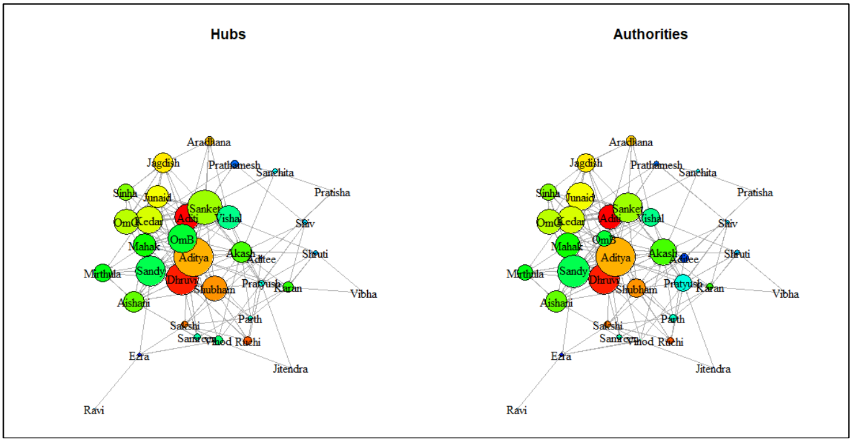
HUBS AND AUTHORITIES:
Authority and hub values are defined in terms of one another in a mutual recursion.
An authority value is computed as the sum of the scaled hub values that point to that page.
A hub value is the sum of the scaled authority values of the pages it points to.

Slide 22
Conclusion
Social Network Analysis in R, Social Network Analysis (SNA) is the process of exploring the social structure by using graph theory.
It helps to measure social network relationships
It helps to measure flows between groups, organizations, and other connected entities.
In this project we observe that the interaction between students of SY Data Science is quite frequent and Aditya being the CR of the class has the highest number of interactions with the students

Slide 23
THANK YOU!!

